Slide 1
Building Intelligent Apps with .NET
Jeremy Likness

Slide 2
01
Why intelligent apps?

Slide 3
Enhanced Customer Experience
Personalization
Predictive analytics
Natural language processing
Engagement | Satisfaction | Loyalty

Slide 4


Operational Efficiency
Automation
Real-time insights
Smart recommendations
Automated recognition of patterns and anomalies
Optimize Workflows
Cut Costs / Reduce Spending

Slide 5

Speed to Market
Faster innovation
Respond to change more quickly
Differentiate rapidly

Slide 6
02
Why .NET?

Slide 7
Ecosystem
AI and Machine Learning
Cross-platform
Python interoperability
Performance
Enterprise grade
Scale / Cloud native
Developer productivity
.NET AI

Slide 8
.NET AI Libraries Microsoft.Extensions.AI and Microsoft.Extensions.VectorData
Streamline AI integration with our unified APIs
Common AI abstractions
Standard middleware
Vector store operations and abstractions
Interoperability and extensibility
Notes:
Jeremy. Talking to models, creating vector databases, and evaluating models, and soon creating agents. You learn one API that integrates into the entire ecosystem. Reusing proven patterns like middleware and dependency injection.

Slide 9



AI and Vector Data
extensions
Cloud
Web
Desktop
Mobile
Integrate
AI Model Provider SDKs
UI Components
AI Libraries
AI Model Provider SDKs
UI Components
AI Libraries
Build
Vector Store Provider SDKs
Apps
Agent Frameworks
Vector Store Provider SDKs
Apps
Agent Frameworks
AI Extensions
Vector Extensions
Core

Slide 10

.NET is “all-in” for AI
Microsoft.Extensions.AI
VectorData extensions
MCP server
AI primitives and building blocks for .NET
Data, semantic search, embeddings
Inter-agent tools and discovery
AI templates
Semantic Kernel
Model eval
Agent Framework
Out-of-the-box guidance with code ready to go
Multi-agentic workflows and orchestration
Model evaluations and scoring
across multiple dimensions

Slide 11
Demo – Introducing “ArtistTool”

Slide 12
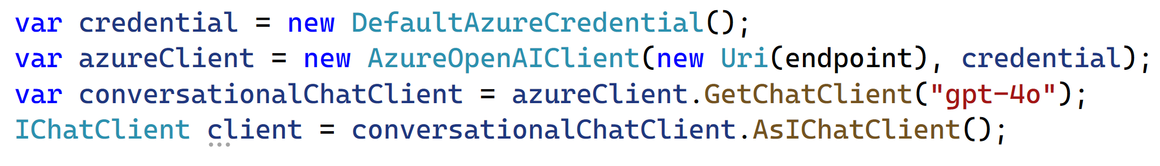
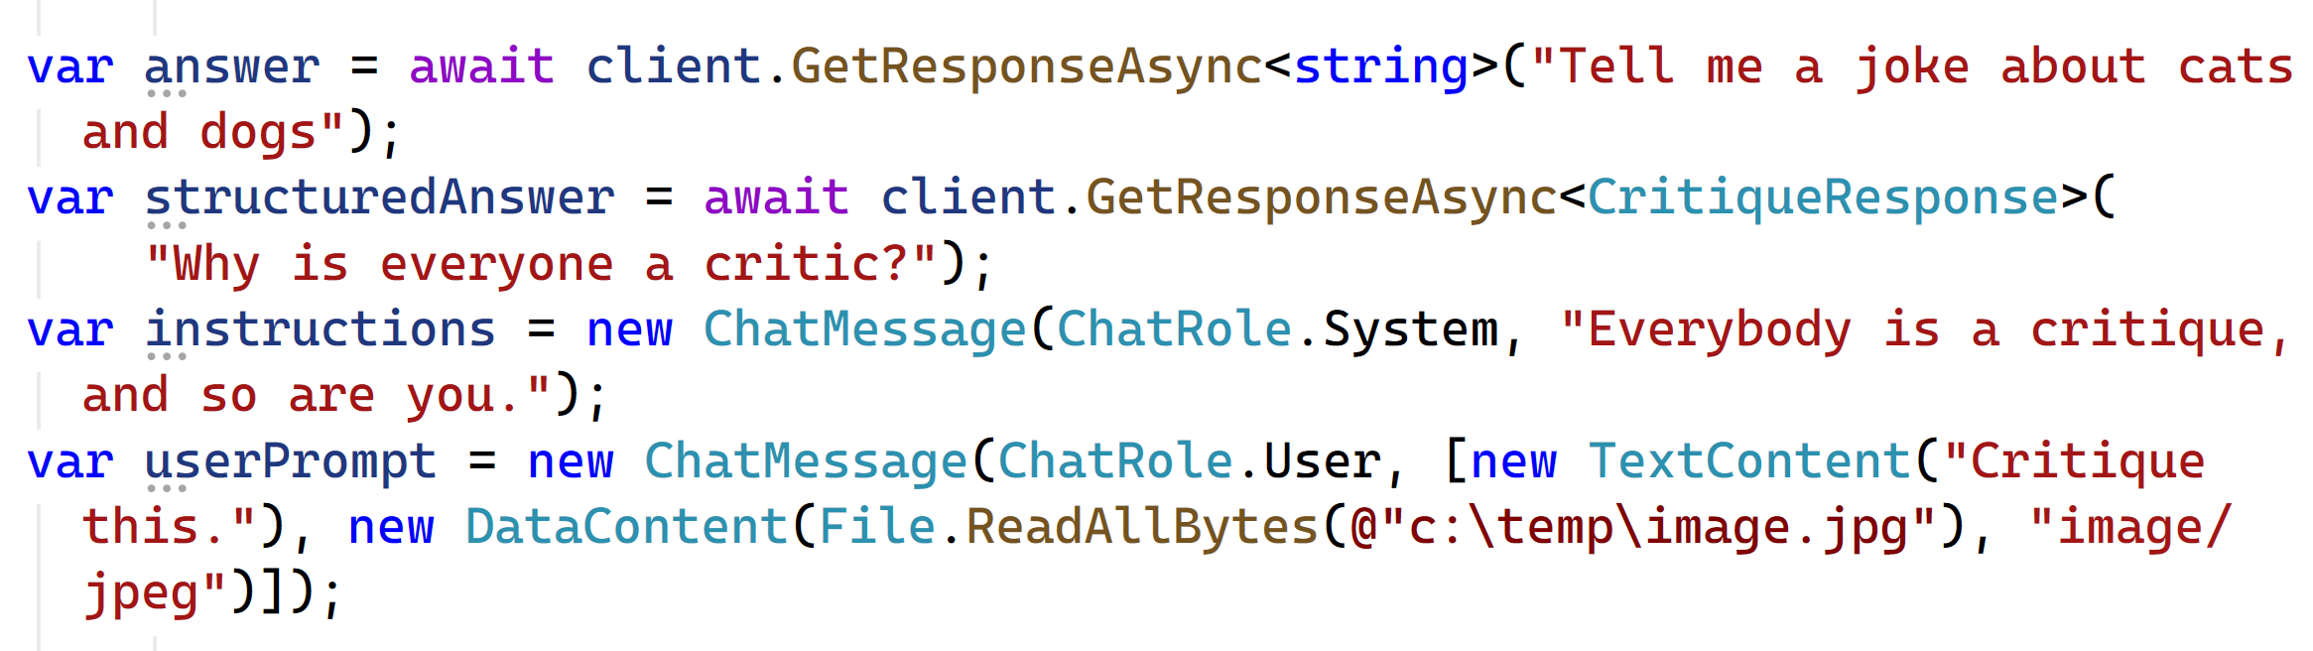

Slide 14
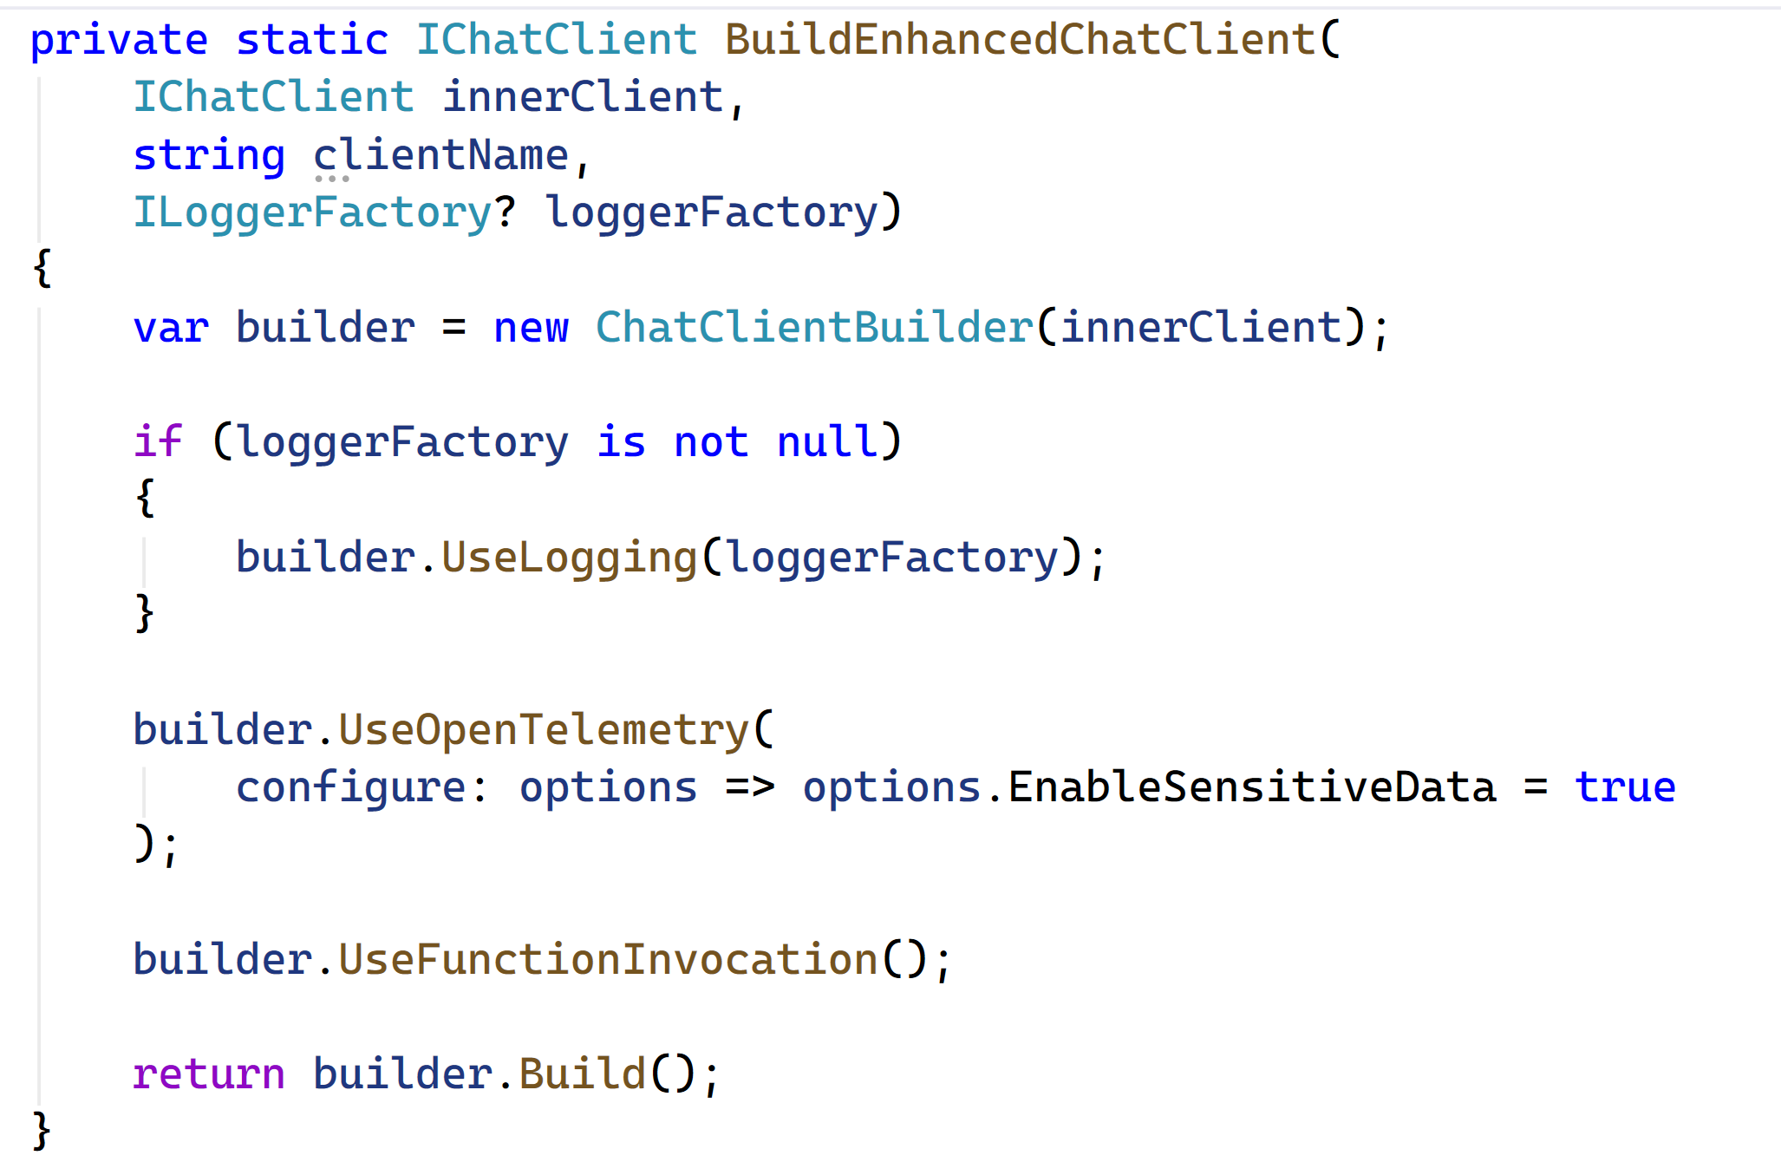

Slide 15
02
Demo – Smart upload

Slide 16
Tokens
Embeddings
Prompt Engineering
Large Language Model
Generative Pre-trained Transformer

Slide 17
03
Demo – Marketing preview

Slide 18
Intelligent Apps
More than chat!
Semantic search / vector database
Model Context Protocol
Tools
Retrieval Augmented Generation (RAG)
Memory
Agents and Workflows

Slide 19
Resources
Intelligent apps
https://learn.mircosoft.com/dotnet/ai
https://learn.microsoft.com/dotnet/ai/microsoft-extensions-ai
https://learn.microsoft.com/dotnet/ai/quickstarts/ai-templates
https://learn.microsoft.com/samples/dotnet/ai-samples/ai-samples
https://learn.microsoft.com/dotnet/ai/quickstarts/build-chat-app
https://github.com/JeremyLikness/ArtistTool/

Slide 20
Thank you

